Slide 1
Review
How long does a command take
> system.time(unique(temp))
> merge(station1, station2, by.x="time1",
by.y="time2")
> match(1:10, c(1,3,5,9))
> as.Date('9/22/1983', format = '%m/%d/%Y')
> julian(as.Date("2013/10/15"),
origin=as.Date("2013/01/01"))
> as.POSIXlt("1983-9-22 23:20:05")
> difftime(as.Date("2013/10/15"),as.Date("2010/06/14"))
> library(package)
> require(package)
> vignette("googleVis")
Merging two data frames
Matching items in two vectors
Date format
Number of days after origin
Day and time object
Difference in dates from one date to another
Loads a package for use (after installing it)
Same as library() but returns FALSE if not installed
More advanced help for some packages

Slide 2
Lecture 7 Data manipulation in practice
Kristin Privitera-Johnson
FISH 552 Introduction to R

Slide 3
Reminder: help in R
Searching for help
help.search("logarithm")
Finding function names
> apropos("log")
[10] "is.logical" "log" "log10"
[13] "log1p" "log2" "logb"
[16] "Logic" "logical" "logLik"
Getting help for a function
> help("log")
> ?log

Slide 4
Reminder: data structures
Vector
One-dimensional
All elements must be the same type
Matrix
Two-dimensional
All elements must be the same type
Some functions require matrices as inputs
Data frame
Same type within a column, all columns the same length
Most commonly used for data
List
Contains data of different types and different lengths
Often the return type for statistic analysis functions

Slide 5
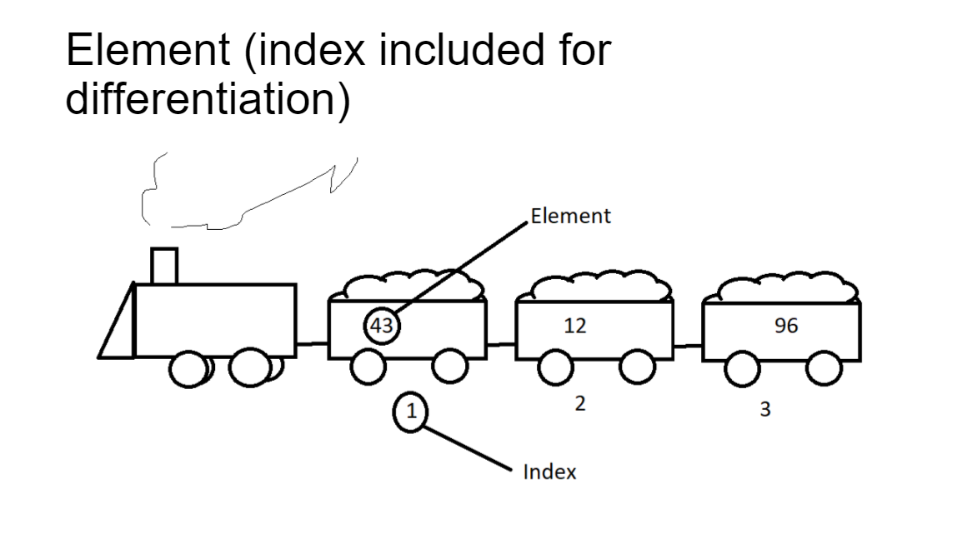

Slide 6
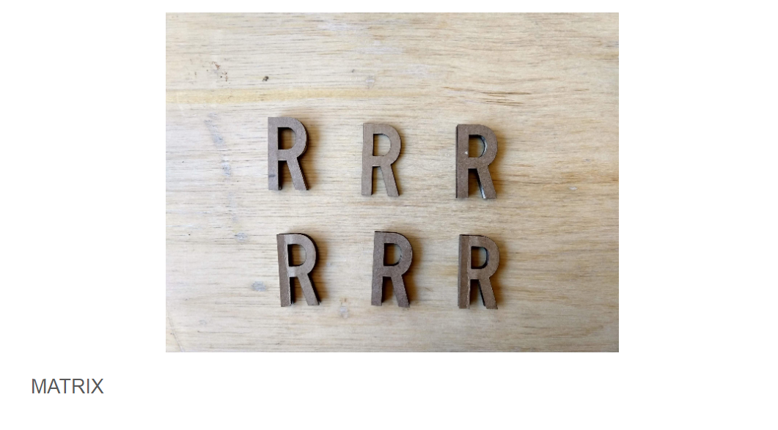

Slide 7
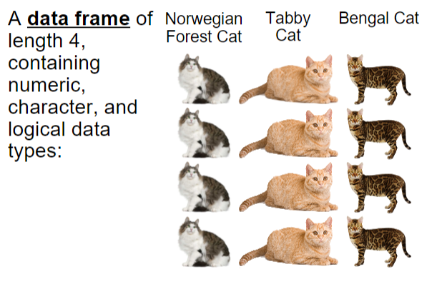
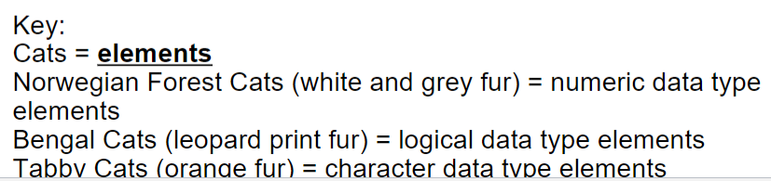

Slide 8
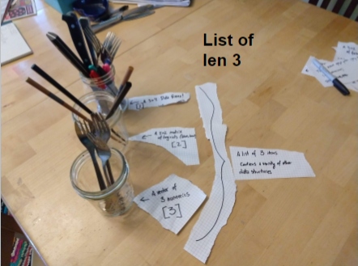

Slide 9
Goal of today’s lecture
The functions presented in previous lectures were presented individually and usually involved simplified data sources
Today we will use many of these functions as a cohesive whole to process some data
The California Passenger Fishery Vessel (CPFV) data from California’s central coast

Slide 10
CFPV data
Contains information on recreational catch from fishing vessels
Data from two ports: Port San Luis (Avila Beach) and Morro Bay
> speciesCode <- read.csv("speciesCode.csv")
> speciesData <- read.csv("speciesData.csv")
> tripData <- read.csv("tripData.csv")

Slide 11
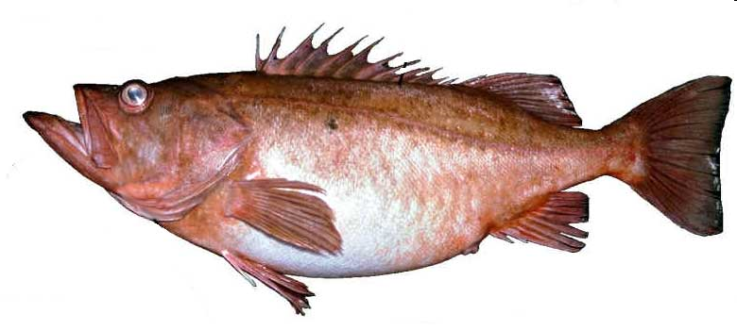
Task to complete
Basic summaries and checks of data
quantitative aspects of the data
checks to make sure the data look “OK”
discovery of NAs and values
Compile species-specific databases
Bocaccio rockfish (Sebastes paucispinis)
All Sebastes species (rockfishes)

Slide 12
What is the number one rule of data analysis?
Always plot your data
(Actually, always check your data first!)

Slide 13
Trip data
Summarizing information about the whole trip
> head(tripData, n=3)
TripNum SimplifiedTripNum Date Year
1 cp1/en.sr 1 2003-07-09 2003
2 cp2/en.sr 2 2003-07-11 2003
3 cp3/en.sr 3 2003-07-14 2003
Port TotalAnglers ObsAnglers
1 San Luis NA 15
2 Morro Bay NA 28
3 San Luis NA 17
ObsAngavg TotalMinutes TotalFish
1 12.35000 208 184
2 21.77778 205 147
3 14.76471 278 175

Slide 14
When do the data begin and end
Strategy: convert the dates to the date class and apply basic statistical functions
> tripData$Date <- as.Date(tripData$Date)
Find the start and end date
> ( min.date <- min(tripData$Date) )
[1] "2003-07-09"
> ( max.date <- max(tripData$Date) )
[1] "2006-10-30"
How many days from the start to the end of the data
> difftime(max.date, min.date)
Time difference of 1209 days

Slide 15
What is the longest data gap?
Strategy: ensure all the observations in tripData are in ascending order by date. Compute the time differences and find the maximum
> tripData <- tripData[order(tripData$Date),]
> diff(c(1,2,4,5,6))
[1] 1 2 1 1

Slide 16
In-class exercise 1
Find the maximum difference in successive dates
Find the row index of this biggest gap
Display rows of tripData immediately before (three rows) and after (three rows) the biggest gap

Slide 17
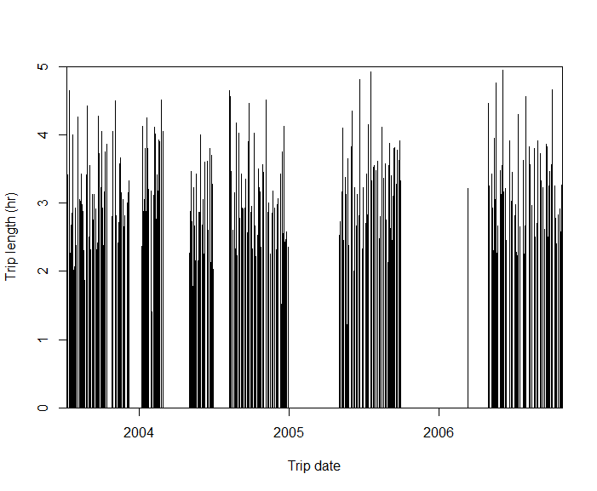
Visualizing trip dates
> plot(x=tripData$Date, y=tripData$TotalMinutes/60,
+ type="h", ylim=c(0,5), xaxs="i", yaxs="i",
+ xlab="Trip date", ylab="Trip length (hr)")

Slide 18
Species codes
The dataset speciesCode contains a coded number (used in speciesData), the scientific name, and the common name of 590 groundfish species.
> head(speciesCode, n=4)
SpeciesCode Scientific Common
1 1 Eptatretus deani Black hagfish
2 2 Eptatretus stoutii Pacific hagfish
3 3 Myxine circifrons Whiteface hagfish
4 21 Lampetra tridentata Pacific lamprey

Slide 19
Species data
The dataset speciesData is the master data set containing data about each individual fish caught
> head(speciesData, n=4)
ID TripNum DropNum SpeciesCode Length Weight Fate TagNum
1 1 1 1 2308 30.0 538.641 K NA
2 2 1 1 2307 26.0 NA RD NA
3 3 1 1 2307 24.5 311.845 K NA
4 4 1 1 2307 25.0 311.845 K NA

Slide 20
What species was caught most?
Strategy: obtain the most frequent species code count from speciesData and then find the corresponding species in speciesCode
> speciesCounts <- table(speciesData$SpeciesCode)
> maxCode <- as.numeric(names(speciesCounts[
which.max(speciesCounts)]))
> maxCode
[1] 2330
> max.spp <- speciesCode[speciesCode$SpeciesCode ==
maxCode,]
> max.spp
SpeciesCode Scientific Common
300 2330 Sebastes mystinus Blue rockfish

Slide 21
Creating species-specific datasets
To create a dataset about bocaccio rockfish from all the relevant data sets
Strategy: subset the speciesData to only include bocaccio observations. Use the merge() function to fuse all the data sources together
We will use the grep() function here, which is very useful (similar but more flexible than %in%)
> grep("a", c("a","b","a","c","a","d"))
[1] 1 3 5
> which(c("a","b","a","c","a","d") %in% "a")
[1] 1 3 5

Slide 22
Subsetting the database
Find which species code belongs to bocaccio
> bocaccioRows <- grep("Bocaccio",speciesCode$Common)
> speciesCode[bocaccioRows,]
SpeciesCode Scientific Common
304 2334 Sebastes paucispinis Bocaccio
Subset speciesData to observations where speciesCode is the species code for bocaccio
> bocaccioCode <- speciesCode[bocaccioRows, "SpeciesCode"]
> bocaccioData <- subset(speciesData,
SpeciesCode==bocaccioCode)
> head(bocaccioData)
ID TripNum DropNum SpeciesCode Length Weight Fate TagNum
428 3 10 2334 NA NA RD NA
4408 29 3 2334 46.0 1200 RA NA

Slide 23
Merge the data
We now want to make a single dataset that also includes information about the trip on which the fish were caught
Merge the two datasets
> bocTrip <- merge(bocaccioData, tripData[,-1],
by.x="TripNum",
by.y="SimplifiedTripNum")
Remove the first column, although called TripNum, we need to match on SimplifiedTripNum
Specify the by.x and by.y arguments so it knows which columns to match

Slide 24
Examine the resulting data
> head(bocTrip, n=4)
TripNum ID DropNum SpeciesCode Length Weight
1 3 428 10 2334 NA NA
2 29 4408 3 2334 46.0 1200
3 35 5161 4 2334 44.5 1080
4 35 5170 4 2334 42.0 900
Fate TagNum Date Year Port TotalAnglers
1 RD NA 2003-07-14 2003 San Luis NA
2 RA NA 2003-09-04 2003 San Luis 31
3 RA NA 2003-09-18 2003 Morro Bay 20
4 RD NA 2003-09-18 2003 Morro Bay 20
ObsAnglers ObsAngavg TotalMinutes TotalFish
1 17 14.76471 278 175
2 13 12.33333 139 181
3 10 12.50000 175 169
4 10 12.50000 175 169

Slide 25
In-class exercise 2
Create a data frame by subsetting speciesData to include all rockfish species (scientific name Sebastes) using speciesCode to find the corresponding codes
Provide a table() of the fates of rockfish by species code
Calculate the minimum and maximum length recorded for each rockfish species
*Advanced: repeat question 2, but obtain a table() of fate vs. common name
Useful functions include grep(), %in%, table(), names() and tapply(). Also sort(), unique().

Slide 26


Slide 27
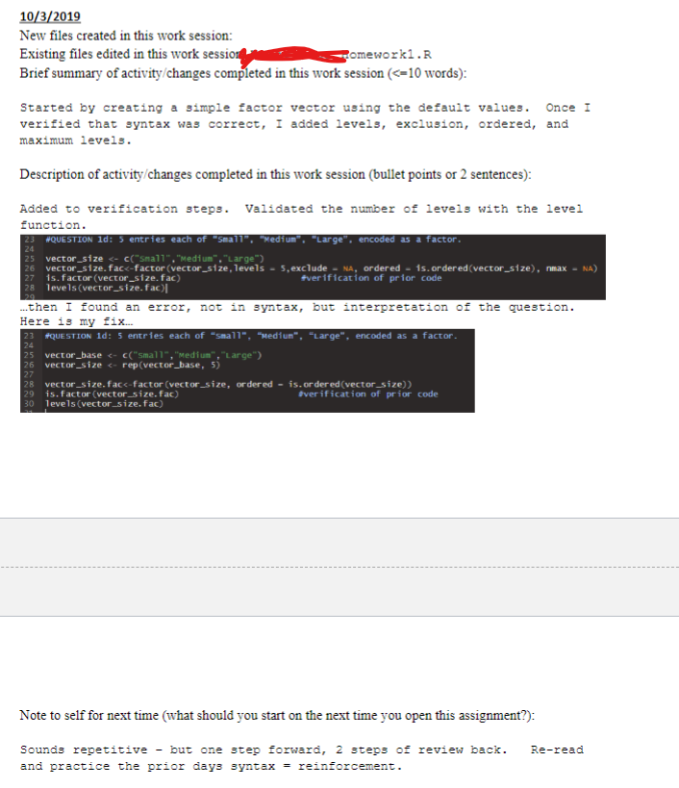

Slide 28
